Slide 1
Split Smart Design and Architecture
Samuel Stenerson, Deniz Acikbas, Kyle McCarthy, Parashar Parikh, Murad Tawfiq

Slide 2
INTRODUCTION
Purpose
The architecture and design document provides a comprehensive overview of the system, using a number of different architectural views to depict different aspects of the system. It is intended to capture and convey the significant architectural decisions of the design of the system.
Key Features
Account and Group Management
Expense Tracking
User Notifications
Balance Monitoring
Payment Tracking
Report Generation

Slide 3


Architectural Representation, Goals, And Constraints
Architectural Representation
Use Case View
Process View
Deployment View
Implementation View
All Views designed using UML
Architectural Goals and Constraints
Compatibility with all commercially available web browsers
Support for high traffic volumes
Interface design for integration with external financial systems
Secure transmission of financial transactions

Slide 4
Use-Case View

Slide 5
Use-Case View
The use-case view of the software architecture describes the set of scenarios and/or use cases that represent critical functionality. It also outlines the scenarios that may exercise many architectural elements or stress a particular aspect of the architecture. The use cases in SplitSmart are as follows (bolded ones have a significant bearing on the architecture):
Create User Account
Create Group
Add Expense
Approve Expense
Receive Notification
Track Balance
Record Payment
Generate Report
Edit User Profile
Edit Group Details
Leave Group
Close Account

Slide 6
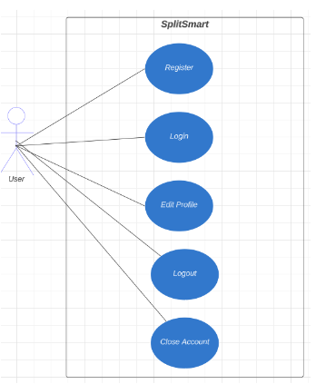
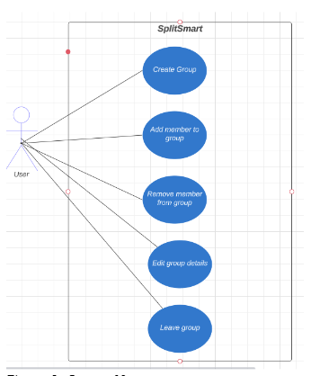
User Account Management
Group Management

Slide 7
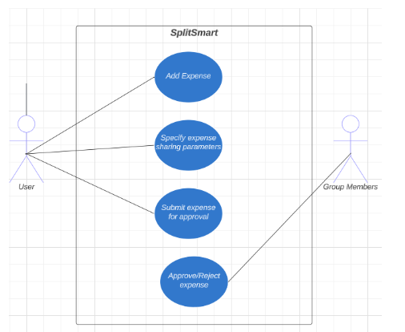
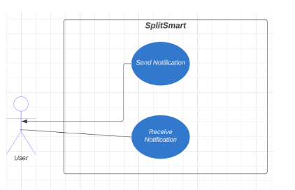
Expense Management
Notification Management

Slide 8
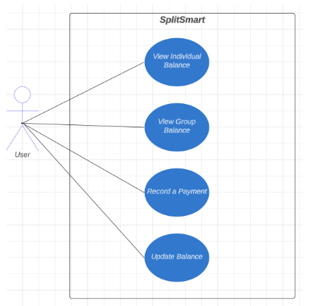
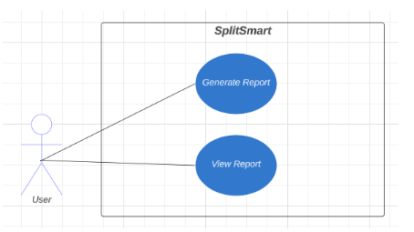
Balance and Payment Management
Reporting

Slide 9
Logical View

Slide 10
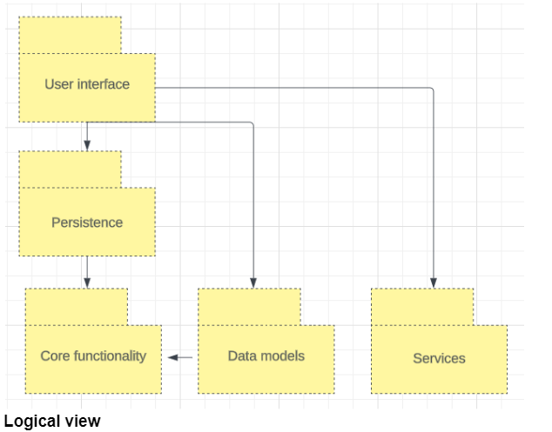
Overview
The logical view of the SplitSmart app provides an overview of its internal structure and organization. It includes the arrangement of classes, their categorization into service packages and subsystems, and the layering of these subsystems.
Main packages
User Interface
Core Functionality
Data and Models
Persistence
Services

Slide 11
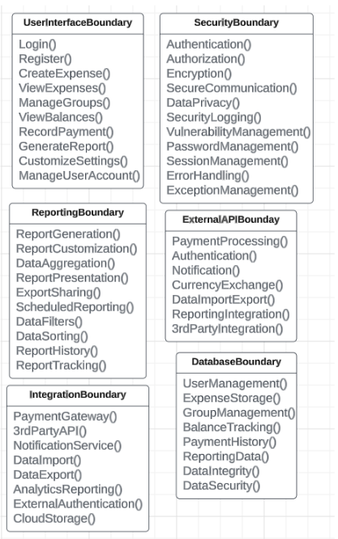
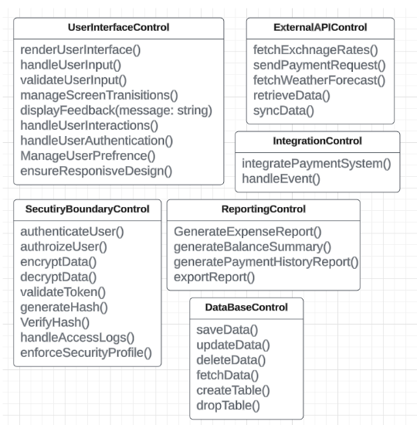
Presentation Package
Application Package

Slide 12
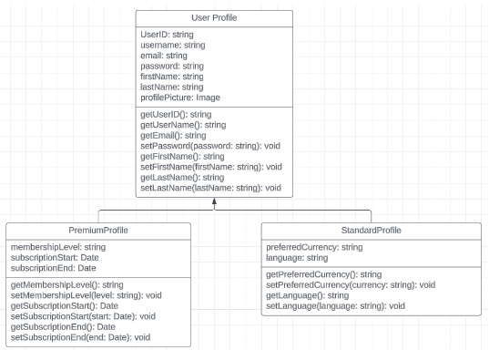
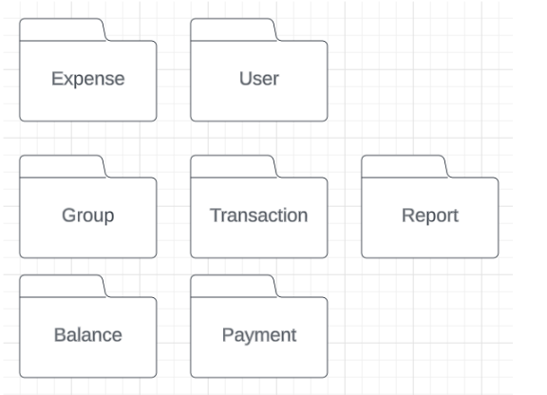
Domain Package
Profile Package

Slide 13
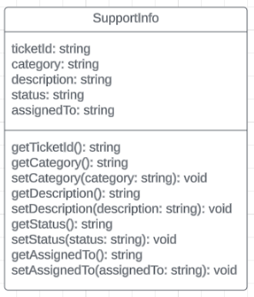
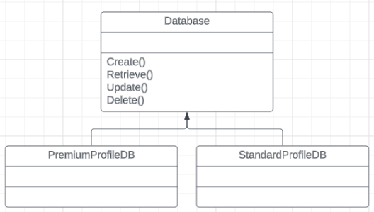
Support Package
Persistence Package
The logical view of SplitSmart emphasizes the organization of classes, packages, and subsystems that collectively contribute to the app's functionality and behavior. These diagrams and other visual representations can be included to illustrate the relationships between architecturally significant classes, subsystems, packages, and layers within the app's logical architecture.

Slide 14
Process View

Slide 15
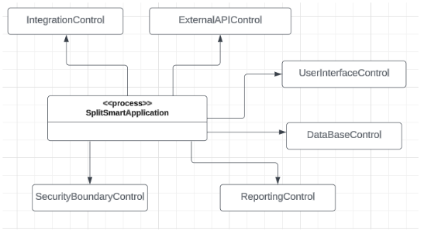
Overview
The server process view represents the main server-level functions of SplitSmart.
It is responsible for handling incoming client requests, coordinating the processing of various application functions, and managing the overall system operation.
The server process interacts with other components of the system to fulfill client requests and provide the required services.

Slide 16
Deployment View

Slide 17
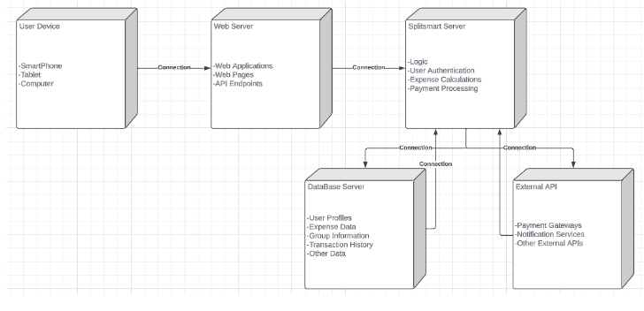
Deployment View of Splitsmart
System Architecture
Client-server architecture
Accessible through various devices: smartphones, tablets, laptops, desktop computers
Web server hosts the SplitSmart application
SplitSmart server handles core functionalities: business logic, user authentication, expense management
Database server manages persistent data
External Integration
Deployment Goals
Integration with external services through APIs: payment gateways, notification services
Ensuring a proper configuration and interconnection of components
Providing a reliable and efficient system
Ensuring seamless user experience and efficient operations

Slide 18
Implementation, Size, Performance, and Quality

Slide 19


Implementation View and Performance
Implementation View
Server software organized into a single layer
Browser client serves as the primary access layer
Size and Performance
Aims for responsive and seamless user experience
Performance optimization techniques include caching, database indexing, and efficient query management
Built to accommodate up to 25,000 concurrent users
Influencing factors: server hardware, network infrastructure, database management, code efficiency
Scaling strategies: load balancing, horizontal scaling, cloud-based infrastructure

Slide 20


Quality Assurance in SPlitSmart
Design and Usability
High standards of design and usability
Distinct design and user experience tailored specifically for managing expenses and balancing accounts
Intuitive and user-friendly interface
Reliability and Security
Prioritizes data accuracy and consistency
Ensures reliable financial management
Provides transparent expense tracking for users

Slide 21
Conclusion

